Slide 1
PROJECT TITLE: Secure data hiding in images using steganography
CAPSTONE PROJECT
Presented By: V.Gokul
Student Name : V.Gokul
College Name & Department : VIT & CSE

Slide 2
OUTLINE
Problem Statement
Technology used
Wow factor
End users
Result
Conclusion
Git-hub Link
Future scope

Slide 3
Problem Statement
Data security is a growing concern in today's digital world, where sensitive information is constantly at risk of unauthorized access.
Cyber threats such as hacking, phishing, and data breaches make it crucial to develop secure communication methods
Traditional encryption methods, while effective, often raise suspicion as encrypted messages stand out in network traffic.
Intercepted encrypted data can be targeted for decryption attempts, making it vulnerable to brute-force attacks.
Steganography offers an alternative approach by concealing information within ordinary media files such as images, audio, and videos, making the hidden data undetectable.

Slide 4
Technology used
Programming Language: Python
Libraries Used:
OpenCV (cv2) – For image processing
OS – To interact with the operating system (e.g., opening files)
String – For character manipulation in encoding and decoding

Slide 5
Wow factors
Dual-layer security: Combines steganography with password protection for enhanced data security.
Seamless user experience: Encrypts and hides data without altering the visible image quality.
Lightweight & efficient: Uses minimal storage and computational power, making it fast and scalable.

Slide 6
End users
Cybersecurity Professionals – Protect sensitive data from unauthorized access.
Journalists & Activists – Secure confidential information in high-risk environments.
Government Agencies – Safeguard classified communications and intelligence data.
Businesses & Enterprises – Secure trade secrets and internal documents.
General Users – Protect personal data, passwords, and confidential messages.

Slide 7
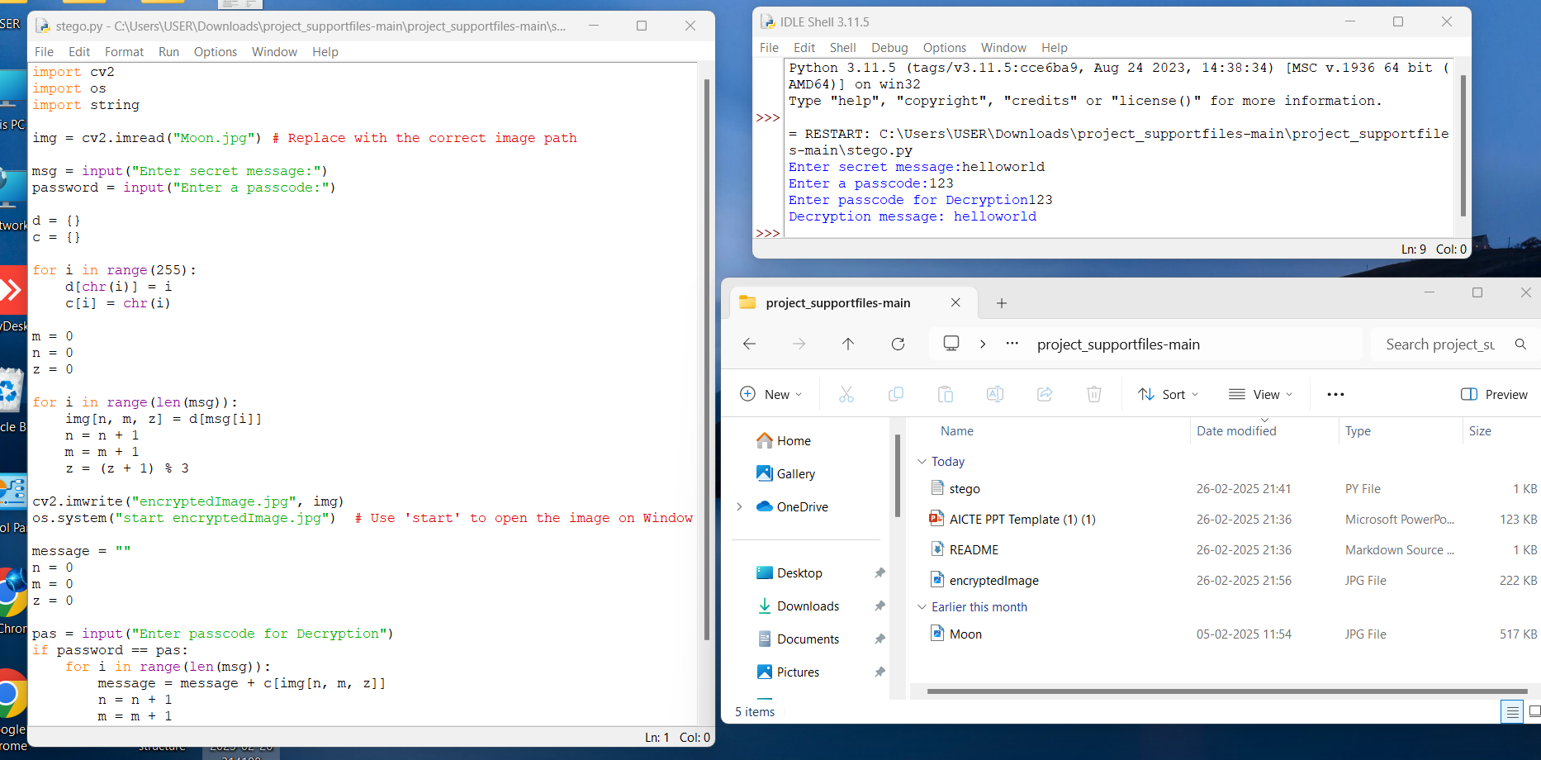
Results

Slide 8
Conclusion
Demonstrates the effectiveness of steganography for secure and hidden data transmission.
Ensures confidentiality by embedding messages inside images without raising suspicion.
Combines encryption and password protection for enhanced security.
Lightweight and efficient implementation makes it accessible for various users.
Can be extended with AI and advanced encryption for future security improvements.

Slide 9
GitHub Link
Project Repository:
Includes source code, README, and usage instructions for easy setup and implementation.
https://github.com/GLTech9/Stenog1

Slide 10
Future scope(optional)
Enhance security by integrating AES encryption before embedding data.
Expand file support to hide data in audio, video, and text files.
Implement AI-based steganalysis detection to identify hidden data in images.
Develop a mobile or web application for easy access and usability.
Integrate blockchain technology for secure and tamper-proof data verification.

Slide 11
THANK YOU

